Slide 1
Metagenomic Assembly of the Human Microbiome with Read clouds
Alex Bishara
Stanford University

Slide 2

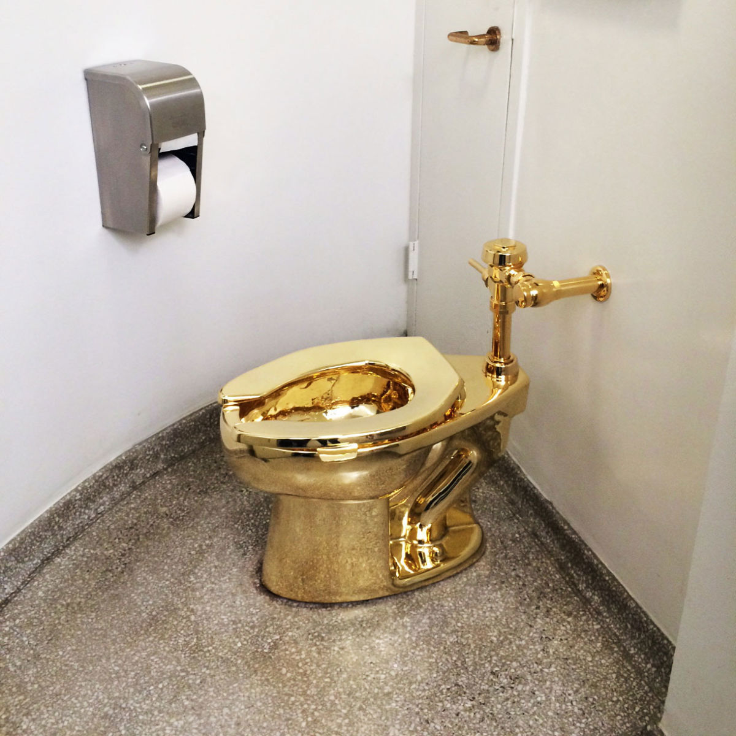
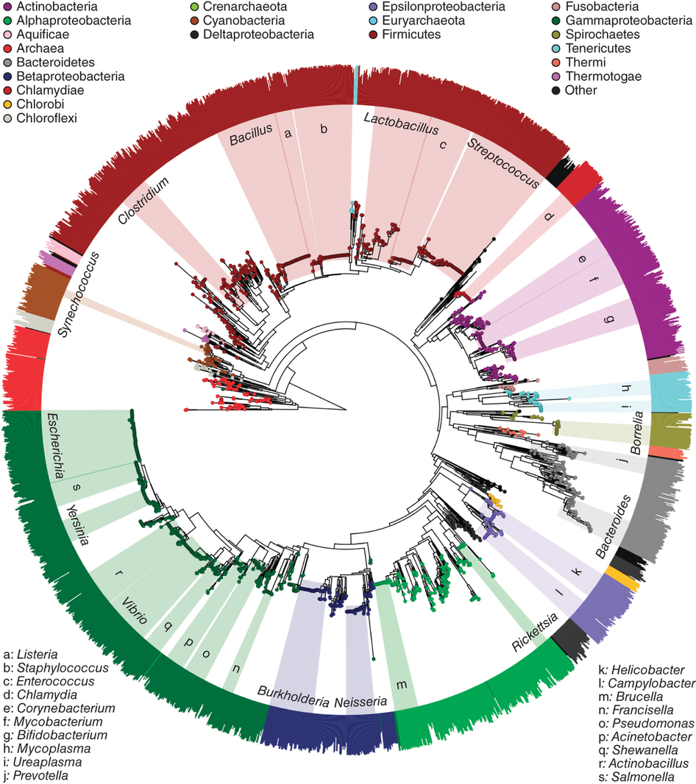
Understanding the Microbiome
Environmental samples contain trillions of microorganisms across many different genera, each with many species
Obtain microbial genomes as a first step to learn something about their function
Langille. Nat Biotechnology 2016

Slide 3
Outline
Preliminaries:
  Metagenomics and sequencing overview
  De novo assembly
  Read cloud sequencing
Read cloud metagenomic sequence assembly
  Overview of read cloud shotgun metagenomics
  Application: stool samples from healthy humans
  Application: pilot study of longitudinal stool samples from a BMT patient

Slide 4
Culture-based Strategies
>99% of microorganisms observable in nature typically are not cultivated by using standard techniques (Hugenholtz et al, J. Bacteriology 1998)

Slide 5
Shotgun Metagenomics

Slide 6
Shotgun Metagenomics

Slide 7
Shotgun Metagenomics

Slide 8
Shotgun Metagenomics

Slide 9
De novo Assembly

Slide 10
De novo Assembly

Slide 11
De novo Assembly

Slide 12
De novo Assembly

Slide 13
De novo Assembly
Conserved sequences, small mobile elements, and HGT all cause branches → fragmented assembly

Slide 14
Shotgun Metagenomics

Slide 15
Solution: Read clouds
Partition long DNA fragments into compartments and create barcoded short-fragments within each

Slide 16
Solution: Read clouds
Partition long DNA fragments into compartments and create barcoded short-fragments within each

Slide 17
Solution: Read clouds
Partition long DNA fragments into compartments and create barcoded short-fragments within each

Slide 18
Solution: Read clouds
Partition long DNA fragments into compartments and create barcoded short-fragments within each

Slide 19
Solution: Read clouds
Long-range information present within each barcode
Coverage of each in *isolation* is too low to directly de novo assemble source long fragment DNA

Slide 20
Outline
Preliminaries:
  Metagenomics and sequencing overview
  De novo assembly
  Read cloud sequencing
Read cloud metagenomic sequence assembly
  Overview of read cloud shotgun metagenomics
  Application: stool samples from healthy humans
  Application: pilot study of longitudinal stool samples from a BMT patient

Slide 21
Read cloud Sequencing and Athena Assembly
Moss, Bishara. Biorxiv 2017

Slide 22
Microbial Genome Draft Generation
Bishara, Moss. Biorxiv 2018

Slide 23
Assembly of the human gut (P1)
~40Gb sequencing (half lane on HiSeq 4000)
Bishara, Moss. Biorxiv 2018

Slide 24
Assembly of the human gut (P2)
Bishara, Moss. Biorxiv 2018

Slide 25
Assembly of the human gut
Bishara, Moss. Biorxiv 2018

Slide 26
Comparisons to Refseq
Bacteroides fragilis
Bishara, Moss. Biorxiv 2018

Slide 27
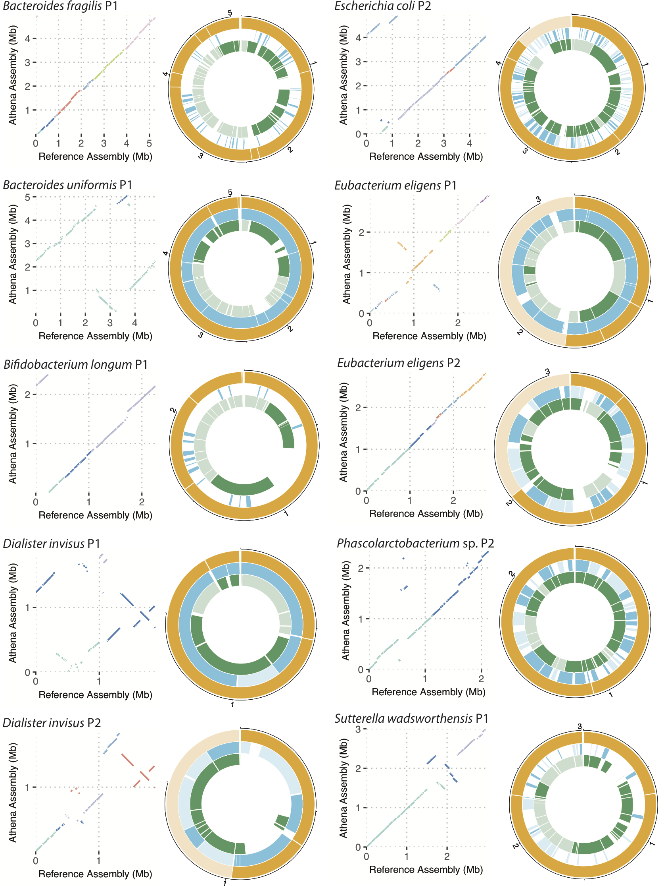
Comparisons to Refseq
Median sequence identity 98.5%
~16% of bases unaligned initially!
Bishara, Moss. Biorxiv 2018

Slide 28
Outline
Preliminaries:
  Metagenomics and sequencing overview
  De novo assembly
  Read cloud sequencing
Read cloud metagenomic sequence assembly
  Overview of read cloud shotgun metagenomics
  Application: stool samples from healthy humans
  Application: pilot study of longitudinal stool samples from a BMT patient

Slide 29
Results: Clinical Samples
Applied read clouds and Athena to study patient with hematological malignancy undergoing HSCT
Moss, Bishara. Biorxiv 2017

Slide 30
Results: Clinical Samples
Applied Athena to study patient with hematological malignancy undergoing HSCT
Short-read abundance estimates show large outgrowth of B. caccae post-transplantation

Slide 31
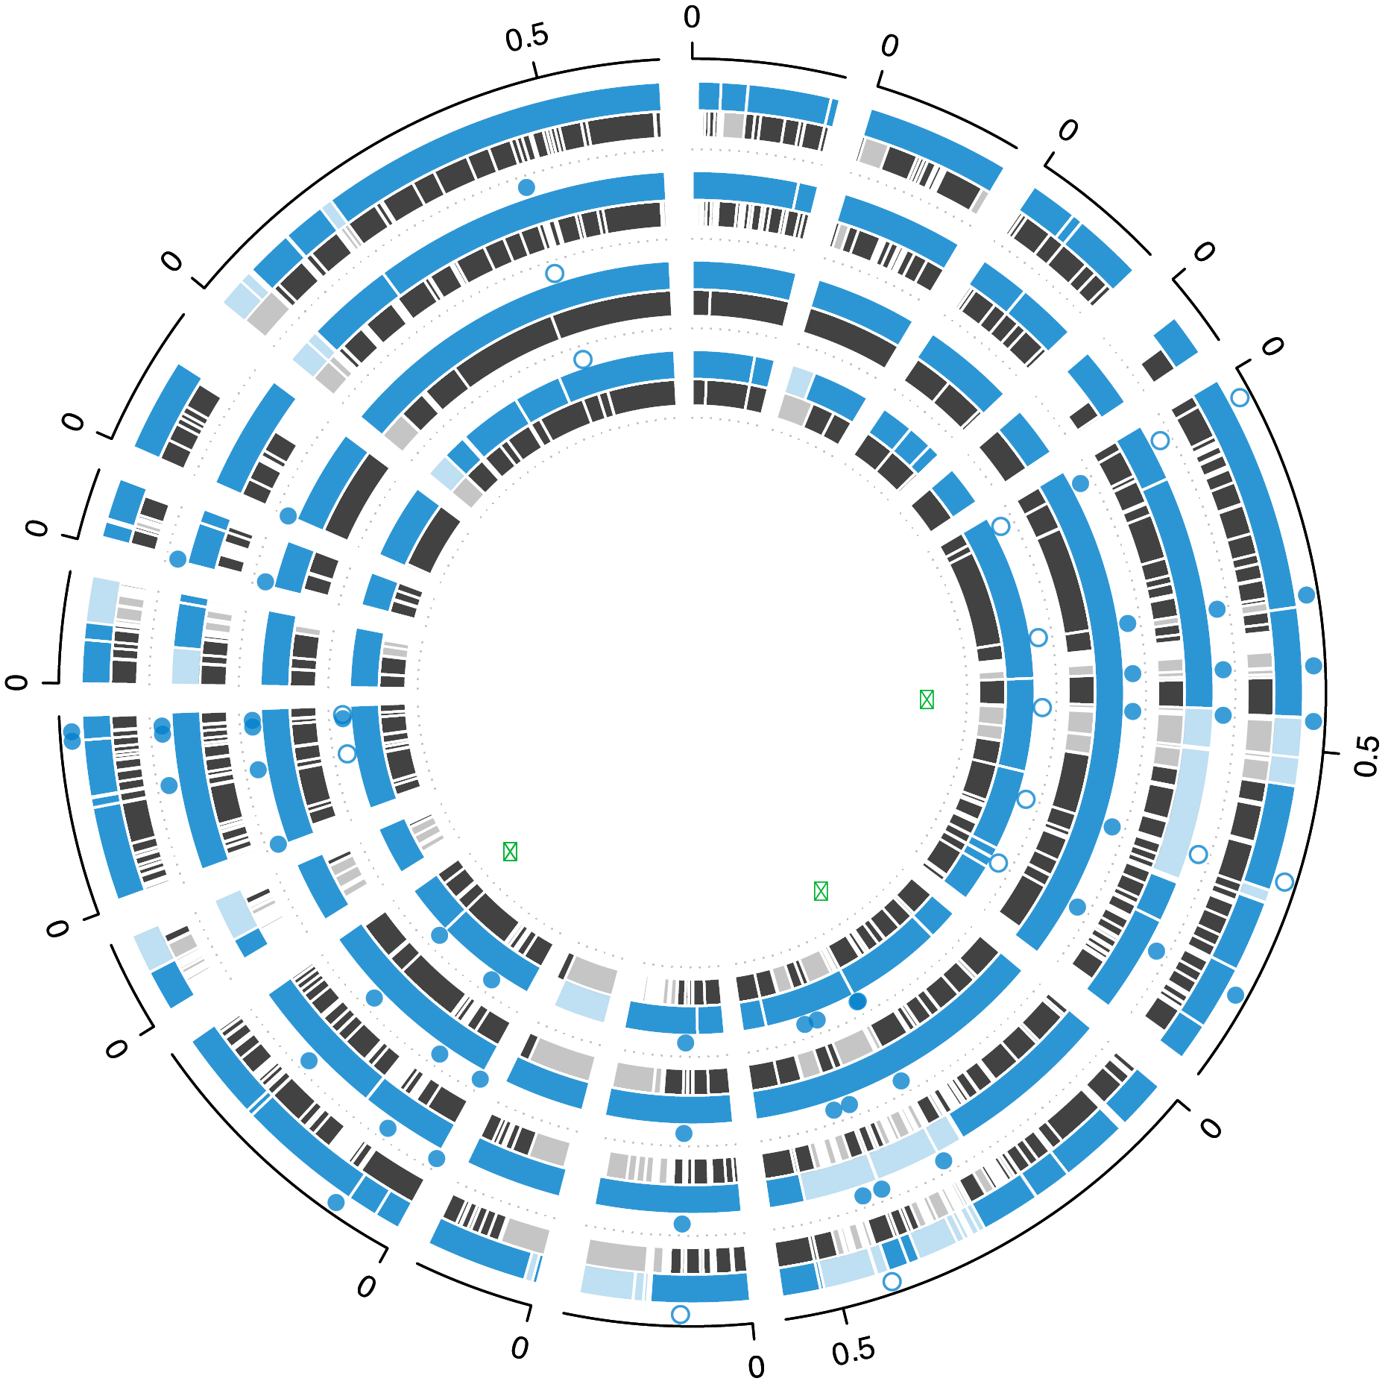
B. caccae drafts
Assembled B. caccae across time points A, B, C, D.
In time point C, Athena had N50 390kb and genome size 5.5Mb vs. SR-assembly N50 61kb and genome size 4.5Mb
Moss, Bishara. Biorxiv 2017

Slide 32
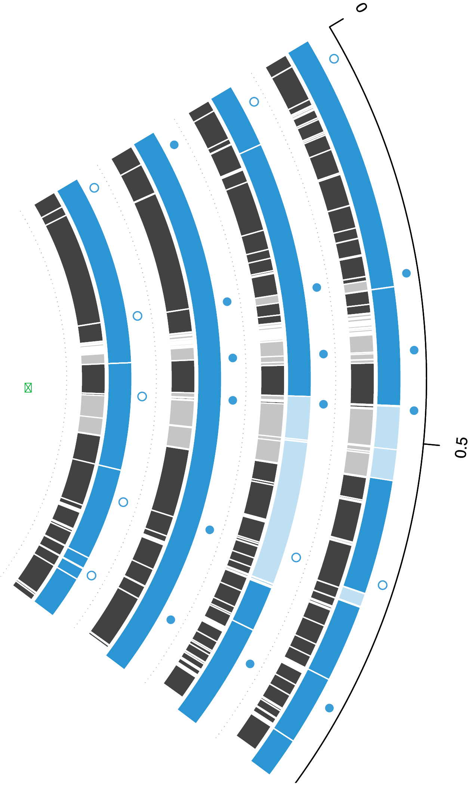
B. caccae drafts
Assembled B. caccae across time points A, B, C, D.
In time point C, Athena had N50 390kb and genome size 5.5Mb vs. SR-assembly N50 61kb and genome size 4.5Mb
Assembled 17 instances of a 1.5kb transposon IS612
Moss, Bishara. Biorxiv 2017

Slide 33
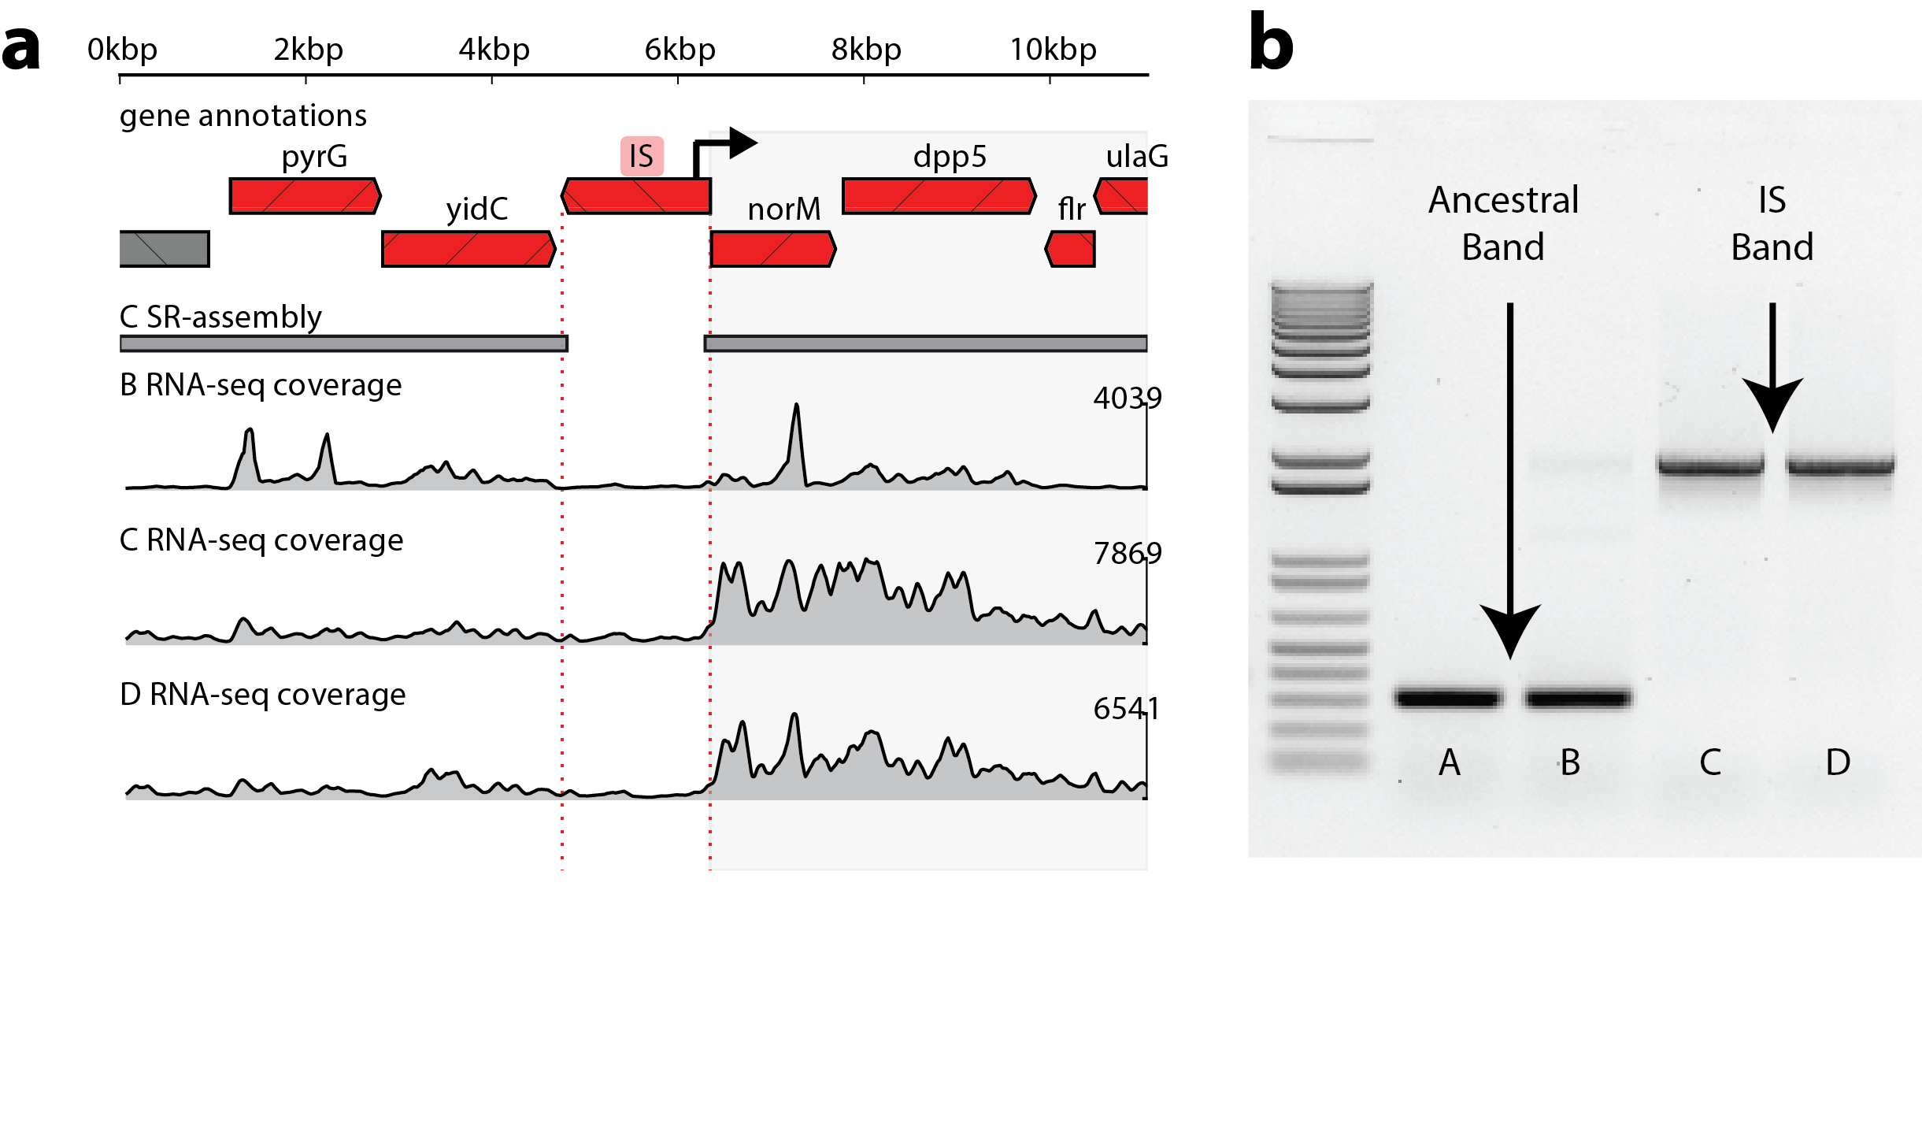
Transposon-mediated upregulation
IS612 harbors an antisense putative bacterial promoter
Performed RNA-seq to inspect changes in transcription across B, C, D
Multi-drug resistance protein norM!
Antibiotics!
Moss, Bishara. Biorxiv 2017

Slide 34
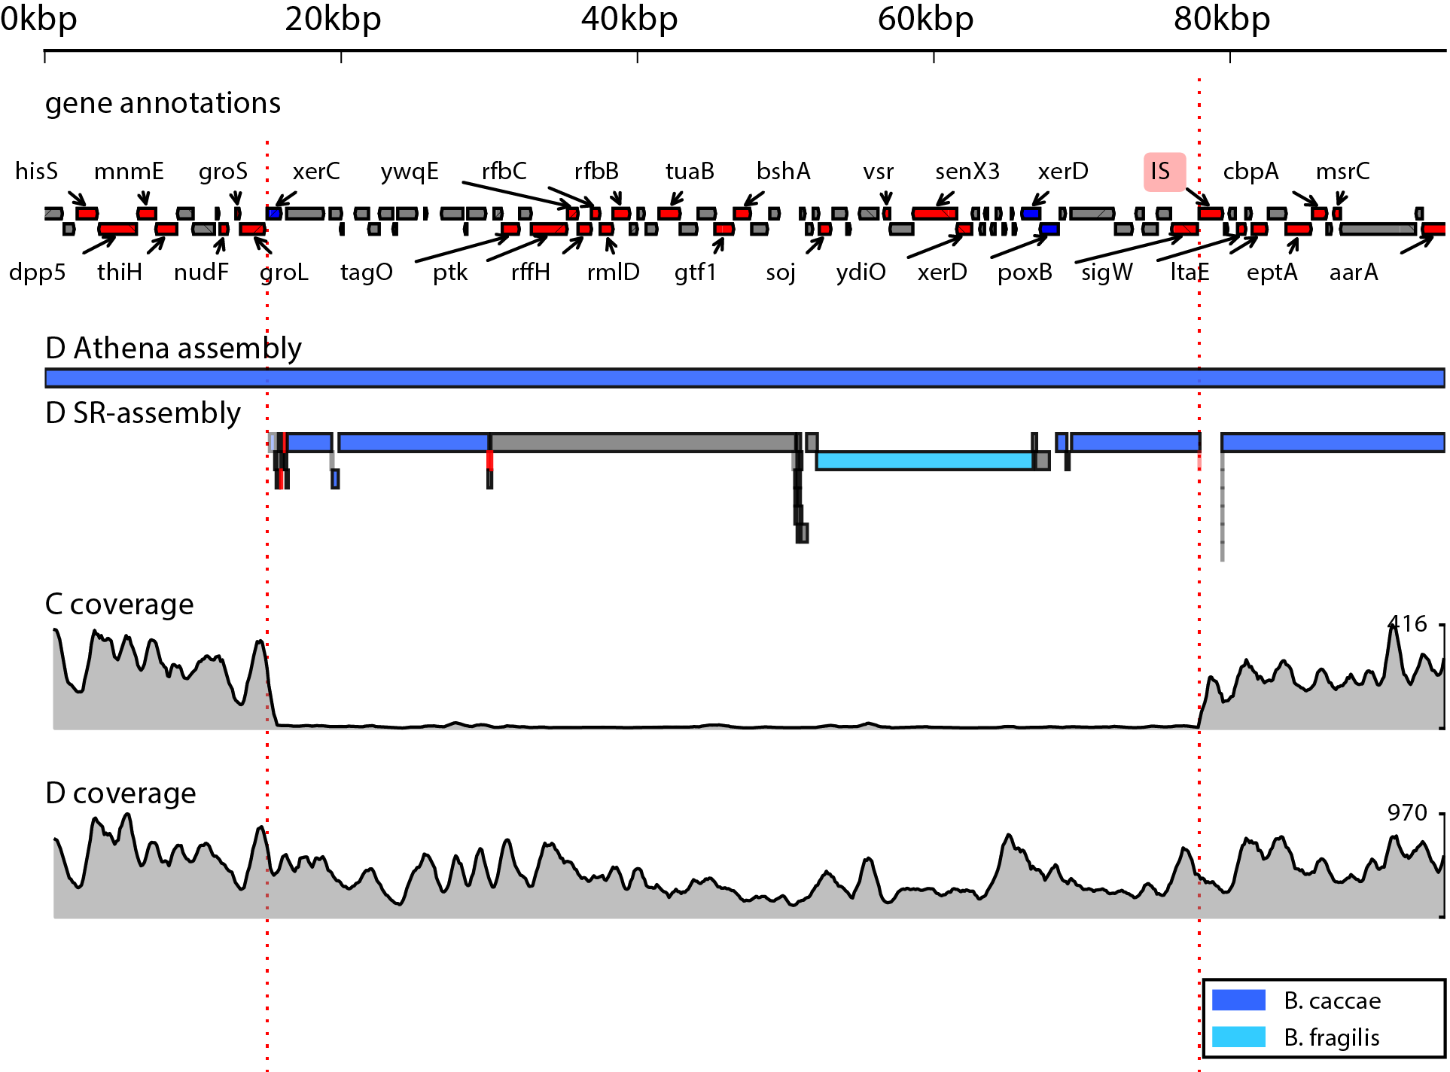
Assembly of a 60kb island incorporation
Assembled integration of a 60kb payload
Sweeps to dominance from C to D
Payload includes: xerC+xerD tyrosine recombinases and four-gene operon for Streptomycin biosynthesis
Moss, Bishara. Biorxiv 2017

Slide 35
Assembly of a 60kb island incorporation
Assembled integration of a 60kb payload
Sweeps to dominance from C to D
Payload includes: xerC+xerD tyrosine recombinases and four-gene operon for Streptomycin biosynthesis
Known recognition site of the xerC+xerD system overlaps an integration of IS612
Moss, Bishara. Biorxiv 2017

Slide 36
Conclusions
Now possible to shotgun sequence microbiome samples and recover individual genomes
Prevalent microbes in heavily sequenced niches (human gut) differ substantially from references and each other (~98% identity, 15% bases unaligned)

Slide 37
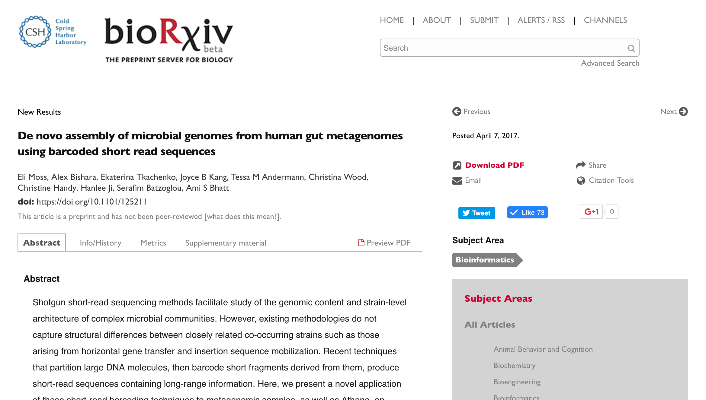
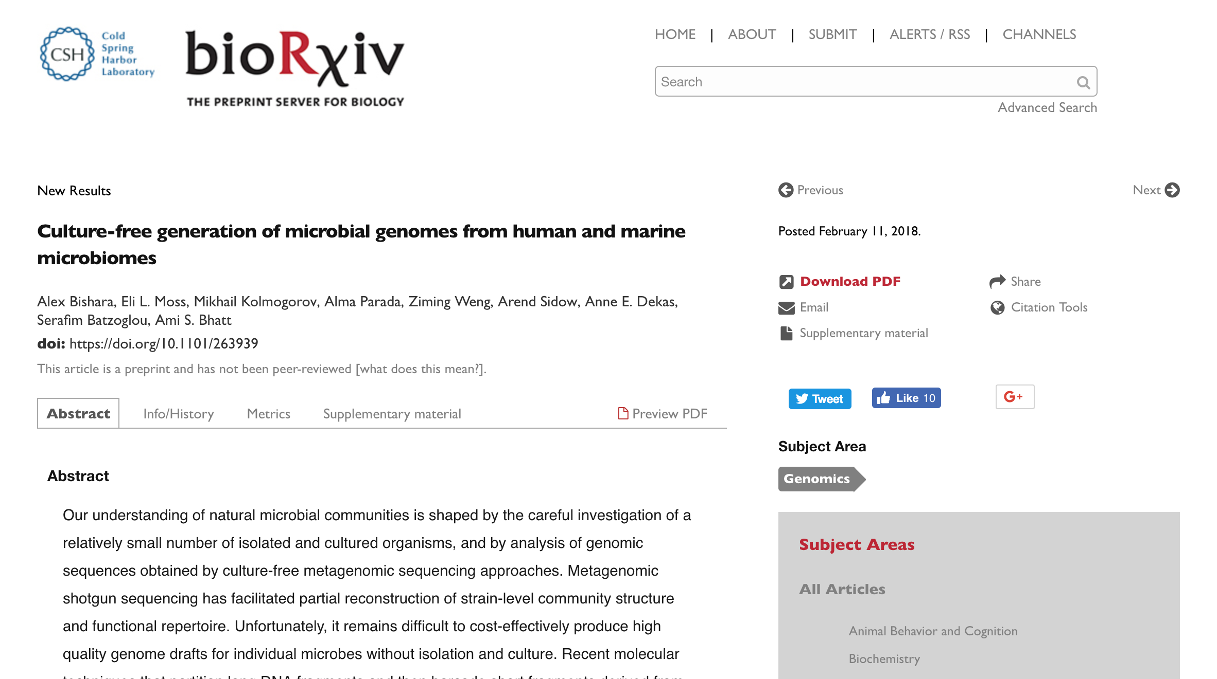
Acknowledgements
Serafim Batzoglou and Ami Bhatt
Eli Moss
Katia Tkachenko
Joyce Kang
Tessa Andermann

